Slide 1

Index
Bible Class Atlas
INDEX
  Assyrian Empire
  Babylonian Empire
  Persian Empire
NEW Testament
  Alexander the Great
  Roman Empire
  Israel in the New Test
  Childhood of Jesus
  Paul-1st Missionary Journey
  Paul-2nd Miss. Journey
  Paul-3rd Miss. Journey
  Paul to Caesarea
  Paul- Journey to Rome
  Paul- Letters to Church
  Corinth/Athens 1 - 2 – 3
  Thessalonica / Berea
  7 Churches - Revelation
  Modern Israel
OTHER
  Blank Maps of Israel, Sinai & Bible Land Area, Greece, Turkey, globe
  Measures: Cubit , Cubit2, Reed, Weights
  Tips / More Resources
OVERALL MAPS
  Bible Lands Overview
  Important Ancient Lands
  Continents & Land Masses
OLD Testament
  Garden of Eden
  Noah’s Ark 1
  Noah’s Ark 2
  Noah’s Ark Mt. Ararat
  Tower of Babel
  Abraham’s Journey
  Abraham Journey to Egypt
  Abraham in Canaan
  Wandering’s of Jacob
  Joseph’s Journey to Egypt
  Joseph’s Family to Goshen
  Route of the Exodus
  Exodus Major Events Map
  Twelve Tribes of Israel
  Nations of Canaan
  Solomon’s Israel
  Tabernacle - 1 - - 2 - - 3 -
  Solomon’s Temple
  Herod’s Temple
  Divided Kingdom
Video Projector Maps
Version 3.01
This is FREEWARE. Feel free to copy and give to your friends. For more FREE GRAPHICS for the Sunday School worship and sermons visit:
www.ebibleteacher.com
email: ttaylor@ebibleteacher.com
Provided by:
© Terry Taylor 2004
Notes:
This is the index. Note that this page is “hotlinked”. This means that you can click on the index items above and they will automatically move you to the map indicated.
Click on the “INDEX” at the bottom right hand of each screen to automatically return to the index.
This software is supported by our corporate sponsor. Their support allows you to have this software for free!

Slide 2
Program Tips
INTERACTIVE MAPS: When run in the “presentation” mode, this map set is interactive. That is, the index is hotlinked to the maps. This allows you to simply click on a map in the index & instantly jump to that map set. To go into interactive presentation mode simply click on the presentations icon at the bottom left hand corner of the screen or pick “Slide Show/Play” from the menu bar. Click on “INDEX” to return.
FAST KEYS: On the keyboard the “Home” key takes you to the first slide, the “End” key goes to last slide, “PgUp” & “PgDn” keys take you forward & backward one slide at a time. To switch to another program hold down the “alt” key & press “tab”.
EDITING MODE: If you want to copy images into your own slide presentations then simply click on the image that you want and then cut and paste it into your own presentation. There is no fee for this use. A few rules do apply. See the last slide for requirements.
More Tips
If while running in the interactive mode you got to this slide by accident press the “PgUp” key or click here to go back to the index :
INDEX
Notes:
Although Microsoft does not allow you to “minimize” a slide show during presentation mode, you can still switch between active slide shows or between this slide show and you Bible software simply by holding down the “alt” key and pressing the “tab” key simultaneously. You can also change PowerPoint to show in a smaller window.

Slide 3
More Tips and Tricks
1. FONT SIZE: This program is designed for video projection and uses large fonts for maximum visibility. Prior to using in your class or sermon, try viewing the slides from the most distant seat in your room to make sure that the image is large enough to read the text.
2. EDITING: To make it easy for you to copy these maps into your own presentations the map graphics and text are “grouped”. If you want to make significant changes to the map then click on “Draw” and chose the “ungroup” feature to allow full editing capability.
3. INFORMATION: There is considerable map background information in the “Notes” mode of this presentation. Simply click on the icon or click “View/Notes Page” from the menu above.
4. IMPORTING: These maps can be imported into some other software packages such as Corel Presentations. Be aware that some formatting will be lost and images will need to be edited and corrected after importing.
INDEX
Notes:
Many of the other maps have information shown in the bottom of this window.

Slide 4
Bible Lands Overview
Thánh Kinh Địa Lý
Nam Âu
Trung Đông
Tiểu Á
Bắc Phi
© EBibleTeacher.com
INDEX
Notes:
This slide shows the major areas of the earth covered by the Bible text.

Slide 5
Important Ancient Lands
Những vùng đất trong Kinh Thánh
Những Khu vực Cổ Quan trọng
Macedonia
La Mã
Hi lạp
7 Hội thánh
Tiểu Á
Medo
Ba Tư
Địa Trung Hải
Canaan & Israel
Đế quốc
Babylon
Ai cập
© EBibleTeacher.com
INDEX
Notes:
This slide gives an overview of the major lands mentioned in the Bible.

Slide 6
Continents & Land Masses
Những vùng đất trong Kinh Thánh
Lục Địa
Nam Âu Châu
Tiểu Á
Địa Trung Hải
Trung Đông
Bắc Phi
© EBibleTeacher.com
INDEX

Slide 7
Garden of Eden
Vườn Eden
Vườn
Eden
Địa trung Hải
Israel
Ai cập
© EBibleTeacher.com
INDEX
Notes:
GARDEN OF EDEN
DISCUSSION QUESTION: What was the Garden of Eden?
The Garden of Eden is described in the Bible as a wonderful and beautiful place and the original home of man. The book of Genesis says in chapter 2 beginning with verse 8: “8 Now the LORD God had planted a garden in the east, in Eden; and there he put the man he had formed. 9 And the LORD God made all kinds of trees grow out of the ground--trees that were pleasing to the eye and good for food. In the middle of the garden were the tree of life and the tree of the knowledge of good and evil.”
DISCUSSION QUESTION: What modern country is the site of what was once the Garden of Eden? According to the Bible, the Garden of Eden was near several rivers.
Genesis 2:10 “A river watering the garden flowed from Eden; from there it was separated into four headwaters. 11 The name of the first is the Pishon; . . . 13 The name of the second river is the Gihon; . . . 14 The name of the third river is the Tigris ; . . .And the fourth river is the Euphrates. 15 The LORD God took the man and put him in the Garden of Eden to work it and take care of it."
Iraq/Iran
Although we do not know the exact location of the Garden of Eden we do know that the Tigris and Euphrates rivers are found in the countries of Iraq & Iran and thus near the Garden of Eden. Tradition has located Eden south of the ancient city of Ur in Iraq. Some people believe that the names have changed and that the Garden of Eden was really located in the land of Egypt between the Blue and White Nile rivers.

Slide 8
Noah’s Ark 1
Tàu Nô ê
Núi
Ararat
(Turkey)
Địa Trung Hải
Israel
(Future)
Ai cập
© EBibleTeacher.com
INDEX
Notes:
NOAH’S ARK
DISCUSSION QUESTION: What was Noah’s Ark? (Teachers should try to get their students to tell these basic Bible stories. Teachers should reread these stories in the Bible themselves prior to coming to class. For Noah’s ark, read Genesis chapters 7 and 8.)
God became displeased with the increasing wickedness of man and determined to destroy mankind with a great flood. According to Genesis chapter 7 and 8, only Noah and his family were saved from the flood by entering a great 450 foot long boat called an “ark” that God had them construct. The book of Genesis tells us that God sent great rains on the earth for 40 days and 40 nights and that the springs of the earth opened up to cover the whole land with a flood of water. This ark floated on the water for some 150 days before coming back to rest upon the land.
DISCUSSION QUESTION: Where did the Ark come to rest? Genesis 8:4 says “and on the seventeenth day of the seventh month the ark came to rest on the mountains of Ararat.”

Slide 9
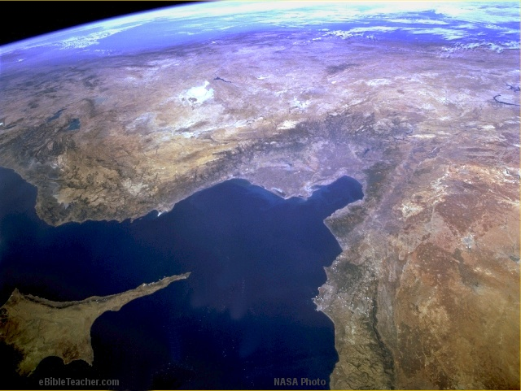
Noah’s Ark 2
© EBibleTeacher.com
Núi
Ararat
Thổ nhĩ kỳ
Địa trung Hải
Israel
Cyprus
NASA Photo
INDEX

Slide 10
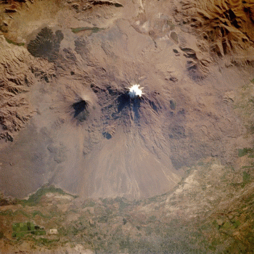
Noah’s Ark Mt. Ararat
Cảnh nhìn từ trên không của đỉnh Ararát tuyết phủ và núi Ararát Nhỏ vốn là những núi lửa không còn hoạt động ở phía Đông Thổ nhĩ kỳ. Núi Ararát cao hơn mặt nước biển 4.800 m. Theo truyền thống, đây là nơi tàu Nô ê tấp vào và ở đó.
Núi Ararat
NASA Photo
© EBibleTeacher.com
INDEX
Notes:
Bức hình này cho thấy nhìn từ trên vệ tinh là đỉnh núi A-ra-rát và Tiểu A-ra-rát có tuyết phủ . Có thể thấy dòng chảy của dung nham xuống phần phía Nam của đỉnh núi. Phía dưới dòng dung nham là những cánh đồng màu xanh.

Slide 11
Tower of Babel
Tháp Babên
Israel
(Tương lai)
Tháp
Babên
Địa Trung Hải
Ai cập
© EBibleTeacher.com
INDEX
Notes:
Tháp BABÊN
Câu hỏi: Tháp Ba Bên là gì?
Genesis chapter 11 tells of how the people stayed together and built a great tower up into the sky. God became angry with the people and confused their language and caused them to scatter throughout the earth. The confusion of language at the Tower of Babel is from where we get the term “babbling” to describe language that makes no sense.
DISCUSSION QUESTION: Why did the people want to build the Tower of Babel?
Genesis 11:4 "Then they said, ‘Come, let us build ourselves a city, with a tower that reaches to the heavens, so that we may make a name for ourselves and not be scattered over the face of the whole earth.” Apparently, the people wanted to “make a name for themselves”. This pride was reprehensible to God. They also didn’t want to spread over the earth. But God had twice previously commanded the people to fill the earth and not stay in one place: Genesis 1:28 “God blessed them and said to them, "Be fruitful and increase in number; fill the earth and subdue it.” and “9:1 Then God blessed Noah and his sons, saying to them, "Be fruitful and increase in number and fill the earth.”

Slide 12
Abraham’s Journey
Hành Trình của Ápraham
Canaan
Cha ran và Urơ của người Canh Đê
(Iraq)
Địa trung Hải
Ai cập
© EBibleTeacher.com
INDEX
Notes:
ABRAHAM
DISCUSSION QUESTION: Chúng ta biết gì về Apraham? Abraham lúc đầu tên là Ápram nhưng Đức Chúa Trời đặt lại tên ông là Abraham trong Sáng 17:5 để nhấn mạnh ông là cha của nhiều dân tộc. Hậu tự của Áp raham bao gồm dân Israel vốn là dòng dõi của Y sác, và dân Arap dòng dõi của Íchmaên.
DISCUSSION QUESTION: Tại sao việc A1praham lìa quê hương được xem là một hành động của đức tin lớn? Abraham được ca ngợi vì đức tin của ông nơi Đức Chúa Trời. Điều quan trọng nhất ông được khen là dựa trên việc ông lìa quê hương đi theo sự chỉ dẫn của Chúa mặc dù không biết Chúa đưa mình đi đâu (Heb 11:8). Điều này chứng minh đức tin sẵn sàng làm bất cứ điều gì Chúa muốn. Du hành thời đó rất nguy hiểm. Người ta không biết nhiều về đất đai chung quanh và cũng không biết mình sẽ đi ngang vùng đất của ai. Không có chính quyền hay luạt pháp gì bảo vệ cho mình. Luật hiện hành là luật của kẻ mạnh.
Đức Chúa Trời hứa rằng Áp raham sẽ có một dòng dõi làm thành một dân lớn (Sáng 12:1-3). Khi Apraham lớn tuổi và bà Sara không có con, bà đã đưa cô hàu gái Aga cho chồng để ông có con nối dõi. Later, God blessed Sarah with a child by Abraham even though she was well past normal childbearing age (Genesis 17:15-17). Finally, as an ultimate test of Abraham’s faith, God commanded Abraham to offer up his son Isaac as a sacrifice. When Abraham obediently began to do this, God stopped him from doing so (Genesis 22:1-18). Like all men, Abraham’s life was not without fault. When Abraham was in Egypt, he was afraid that men would want to kill him and take his wife so he declared that she was his sister (Genesis 20).
God predicted that through Abraham all the people of the world would be blessed (Genesis 22:18). This prophecy came true as a result of Jesus being the direct descendent of Abraham for because of Jesus, the whole world is blessed with the opportunity of salvation.

Slide 13
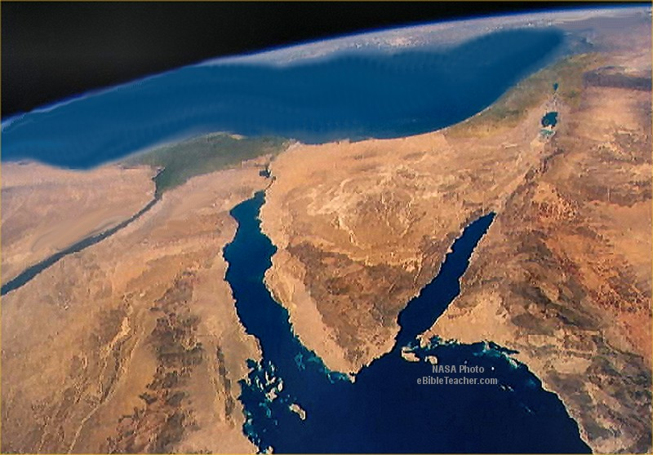
Abraham’s Journey to Egypt
Hành Trình của Ápraham
qua Ai cập
Canaan
Địa Trung hải
Đồng bằng sông Nile
Nile
Ai cập
Sinai
© EBibleTeacher.com
INDEX
Notes:
THE TRAVELS OF ABRAHAM
Genesis 12:1-5
"12:1 The LORD had said to Abram, "Leave your country, your people and your father's household and go to the land I will show you. 2 "I will make you into a great nation and I will bless you; I will make your name great, and you will be a blessing. 3 I will bless those who bless you, and whoever curses you I will curse; and all peoples on earth will be blessed through you." 4 So Abram left, . . . 5 He took his wife Sarai, his nephew Lot, all the possessions they had accumulated and the people they had acquired in Haran, and they set out for the land of Canaan, and they arrived there.
Genesis 12:10 - 13:12
"10 Now there was a famine in the land, and Abram went down to Egypt to live there for a while because the famine was severe."
"13:1 So Abram went up from Egypt to the Negev, with his wife and everything he had, and Lot went with him."
"13:12 Abram lived in the land of Canaan, while Lot lived among the cities of the plain and pitched his tents near Sodom."

Slide 14
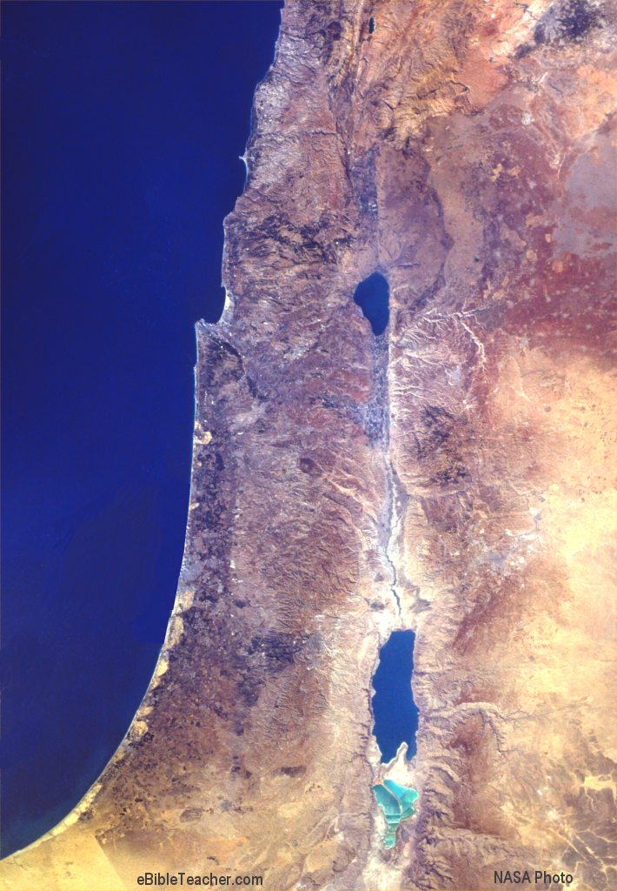
Abraham in Canaan
Đồng cỏ của
Ápraham
Canaan
Địa Trung Hải
Đồng cỏ
của Lót
Hebron
Sodom
INDEX
Notes:
ABRAHAM & LOT
Lot was the nephew of Abraham (Genesis 12:5). The flocks of Abraham and Lot became so numerous that the land could no longer support their great herds. Abraham allowed Lot to chose an area in the land of Canaan in which to live and Abraham took what was left (Genesis 13:5+). In Genesis 13:14, God promised that Abraham descendants would later have this land. This area is now the land of Israel. Lot finally came to live in the city of Sodom. This city became incredibly wicked and God promised to destroy it along with its sister city of Gomorrah with fire and brimstone (sulfur) raining from heaven (Genesis 19:24). Only Lot and his family were saved with the exception of his wife who “looked back” and was turned into a “pillar of salt”. We do not know the specific location of Sodom and Gomorrah. Many believe that it was at the southern tip of the Dead Sea. Even today, there are great salt plains around this sea and animals or plants that are left in this area become encrusted with a thick layer of salt deposit.
DISCUSSION QUESTION: What lessons from the story of Abraham should we learn to apply to our lives today? Perhaps the greatest lesson we should learn from the story of Abraham is that we should learn to trust God. A detailed review of Abraham’s life reveals that Abraham sometimes made mistakes. Even though he was a man of faith, out of fear of Pharaoh he lied about his sister (Genesis 12:10-20). We learn from this story that even good people sometimes fail in their faith.

Slide 15
Wandering’s of Jacob
Gia cốp rời nhà cha đi đến Charan để trốn khỏi Ê sau và cũng để tìm một người vợ. Ông thấy khải tượng về chiếc thang dẫn lên thiên đàng. Nhiều năm sau ông đi trở lại con đường xưa.
Canaan
Địa Trung hải
Chặng đường lang thang của Gia cốp
Biển chết
Hebron
Quê hương của Y sác
INDEX
Notes:
ISSAC/JACOB/ESAU
Isaac was the son of Abraham. He had fraternal twin sons, Jacob and Esau. It was the custom of the firstborn son to receive the greater inheritance but Esau was reckless and sold his birthright to Jacob for food (Genesis 25:29-34). Jacob later deceived his father Isaac into thinking that he was Esau and received Jacob’s blessing (Genesis 27). If fear for his life, Jacob fled the land and got a wife named Rachel from a man named Laban. Finally, Jacob returned to the land and was reunited with his brother. Isaac, Jacob and Esau were all herdsmen and developed great wealth in flocks.
DISCUSSION QUESTION: How did Jacob deceive his father Isaac into thinking that he was his brother Esau? Isaac was fair but Esau was rough and hairy. When Isaac was very old and was blind, Jacob’s mother Rebekah made him a covering of lambskin to simulate the hairy arms of Esau. When Isaac was near death and called for Esau to bless him, Isaac instead showed up with wild game as food and deceived his father. Isaac couldn’t see well enough to distinguish the two brothers and when he felt the lambs wool he thought it was Esau’s hairy arms.
This photo of sheep would have been a familiar sight to the Isaac, Jacob and Esau.
This map shows our best estimate of the wanderings of Isaac and Jacob.

Slide 16
Joseph’s Journey to Egypt
Hành trình của Giô sép đến Ai cập
Canaan
Địa trung Hải
Đồng bằng
Sông Nile
Joseph bị bán cho
thương lái
Nile
Photipha & Pharaon
Ai cập
Sinai
© EBibleTeacher.com
INDEX
Notes:
JOSEPH
Jacob had twelve sons. These sons were named: Reuben, Simeon, Levi, Judah, Dan, Naphtali, Gad, Asher, Issachar, Zebulun, Joseph, Benjamin. DISCUSSION QUESTION: How were the names of these twelve men related to the twelve tribes of Israel and how were they not? Ten of the names of the men are the same names of ten of the tribes of Israel. Joseph, had two of the tribes named after his sons, Mannasah and Ephraim. Levi did was the tribe for the priests and although this tribe would later be given cities in the conquering of Canaan, they did not have a regional land to call their own. Thus, Joseph and Levi did not have tribal regions named after them.
At this time, it was acceptable for men to have several wives at once. Joseph was born to Jacob’s favorite wife, Rachel in Jacob’s old age and Joseph became Jacob’s favorite son. Jacob gave Joseph a coat of many colors (Genesis 37:3). We don’t think too much of such clothes in modern times but in a time that all cloth and dyes were made laboriously by hand such a gift would have been worth a lot of money. God gave Joseph a dream which prophesied that his brothers would serve him. Joseph’s brothers were furious with jealousy and plotted to kill him. His older brother, Reuben intervened and instead they threw him in a deep cistern where he was trapped. Later, when a Ismaelite caravan happened by they saw an opportunity for money and sold him to the Ismaelites (Midianites) as a slave (Genesis 37:27-28).
DISCUSSION QUESTION: Jacob deceived his brother Esau. Later, how was Jacob deceived by his sons? The brothers took Joseph’s precious coat and stained it with the blood of a goat and took it to his father, Jacob as evidence of the death of Joseph by some wild beast. Jacob, who had deceived his brother Esau for the birthright was now being deceived by his sons.
Joseph was taken as a slave to Potiphar, in Egypt who was one of Pharaohs officials over the guard. In this position, Joseph was recognized for his leadership abilities and directed the work of Potiphar’s other servants (Genesis 39:4-6). Joseph was handsome and when he refused the advances of Potiphar’s wife she falsely accused him of attempted rape. Potiphar had him thrown into prison where Joseph’s intelligence and skill again advanced him to head the prison’s workers (Genesis 39:20-23). Finally, Joseph met some of Pharaoh’s servants who had been thrown into prison. Joseph correctly interpreted a prophetic vision of the servants. One of the servants was released from prison to work again for Pharaoh. When Pharaoh had a dream that his wise men couldn’t interpret, the servant remembered Joseph. When Joseph interpreted Pharaoh’s dream as being a prophecy from God about a coming famine, Pharaoh had Joseph appointed to be in charge of the work of the kingdom including the preparations for the 7 year famine (Genesis 41:39-42). Joseph’s family back in Canaan were affected by the famine and came to Egypt for food. They didn’t recognize Joseph and bowed down to him as he had earlier prophesied. Finally, Joseph had them along with his elderly father come to live with him in Egypt in the fertile land of Goshen (Genesis 45). The Egyptians held herders in low esteem and gave them this fertile pasture land (Genesis 46:34). Joseph had two sons, Manasseh and Ephraim. Over the years the number of descendants of these twelve sons became extremely numerous until the point that the Egyptians became concerned that this group of people had too much potential power and made them their slaves (Exodus 1:6-11) .
DISCUSSION QUESTION: How did Joseph’s experiences prepare him to be a leader in Egypt? Joseph started as a hard working herdsman. Later, he got experience in management as the director of Potiphar’s servants and then again in the Prison as he managed the work being done there. Despite his difficulties, Joseph never quit having faith in God and made the best of his situations. God’s gift of miraculous insight to Joseph put him in a position to become the second in command to Pharaoh.

Slide 17
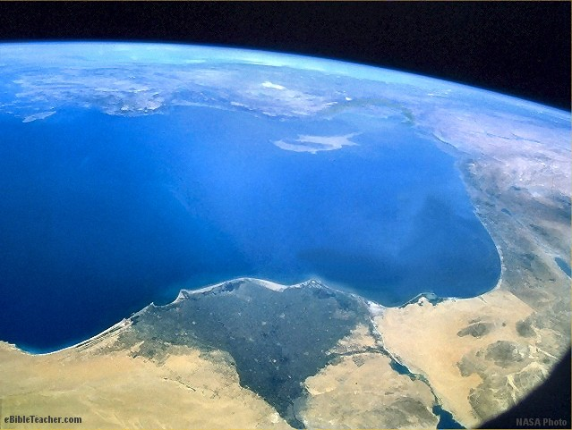
Joseph’s Family to Goshen
Hành trình của gia đình Giô sép
đến Goshen vì nạn đói
Đồng bằng trù phú
Của sông Nile
Canaan
Ai cập
Dr. Rick Griffith • Singapore Bible College • biblestudydownloads.com
©
INDEX
Notes:
DISCUSSION QUESTION: How did Joseph’s family end up living in Egypt? Joseph was released from prison and put in the service of the Pharaoh as second in command of Egypt because he correctly interpreted the Pharaoh’s dream that a great famine was coming. He predicted 7 years of good harvest followed by 7 years of famine. Joseph recommended that Egypt make great stores of food to prepare for the famine. This famine not only affected Egypt but also Israel. Joseph’s father, Jacob, sent his sons to Egypt to get food during the famine. At first Joseph did not reveal who he was to his brothers but finally revealed himself and Jacob and Joseph’s brothers were invited to come and live in Egypt. The Hebrew people (Israelites) were the descendants of this group.
The photo of Joseph’s family journey into Egypt shows the fertile Nile delta as the Nile empties into the Mediterranean Sea. During the famine, this became the home of the Israelites.
DISCUSSION QUESTION: How was it that the Hebrew people became slaves in Egypt? Years after moving to Egypt, the descendants of Joseph’s family became quite numerous. The Egyptians had a distaste for sheepherders and the Hebrews and Egyptians generally did not intermarry. A new Pharaoh who did not know Joseph became concerned that the Hebrew people might rebel against Egypt and put them into slavery. It was into this setting that Moses was born.
DISCUSSION QUESTION: What lessons from the story of Joseph should we learn to apply to our lives today? We learn from the story of Joseph how that a faithful person can be ill treated. We learn a great deal about patience from Joseph. Joseph lived for years as a slave and in prison before God’s final will for his life was made known. Joseph saw no immediate reward for resisting the advances of Potiphar’s wife. He also saw no immediate reward for properly interpreting the dreams of Pharaoh's baker and butler. Despite this fact, Joseph remained faithful and as a result not only he but ultimately his whole family was blessed.

Slide 18
Route of the Exodus
Biển Lớn
(Địa Trung hải)
Canaan
Đồng bằng
Sông Nile
Bán đảo
Sinai
Ai cập
Con đường
Xuất Ai cập
theo truyền thống
Mt. Sinai
NASA Photo
© EBibleTeacher.com
Biển Đỏ
INDEX
Notes:
The slide shows the traditional route of the Exodus. Some say that this route went through the land of Midian that Moses had become familiar with when he fled to the land of Midian to avoid the prosecution for killing the Egyptian. The more popular route to Canaan was the northern route along the Mediterranean. That route had a variety of Egyptian military posts which would likely have resulted in many conflicts with the remaining Egyptian army units that had been detailed to these outposts.

Slide 19
Exodus Major Events Map
Con đường
Xuất Ai cập
theo truyền thống
Biển Lớn
(Địa Trung hải)
Jerico
Canaan
Đồng bằng
Sông Nile
12 thám tử
Bán đảo
Sinai
Chim cút / Manna
Ai cập
Núi Sinai
Mt. Sinai
© EBibleTeacher.com
Biển Đỏ
INDEX
Notes:
DISCUSSION QUESTION: Why did God send them manna and quail in their wanderings? For preparation of this question, the teacher should read Exodus chapter 16. The Israelites grumbled that there was nothing to eat in the desert and God provided food for them. Manna was a sweet flaky material that appeared on the desert floor each morning except on the Sabbath. They could pick this up and eat it. On Friday they could pick up enough for two days, otherwise it would spoil. God also sent quail for them to eat. Quail was a small bird. A trivia note is that the word “manna” literally means “What is it?” because when they saw it they said “What is it?”
DISCUSSION QUESTION: Why do you think that God generally didn’t want them to gather manna for more than one day at a time? It is interesting that except for Friday, the Israelites only received enough food for a day. In the New Testament, the “Lord’s Prayer” says “Give us THIS DAY our daily bread.” In the sermon on the mount in Matthew 6:34 , Jesus said “Therefore do not worry about tomorrow, for tomorrow will worry about itself. Each day has enough trouble of its own.” What is the practical message from this? We learn that we should not worry too much about things. Again and again, God tells us to just take care of the day.
MOUNT SINAI
The map shows the location of the range of mountains known as the Sinai mountain range. Although we think that we know the general area, we don’t know the exact mountain that Moses went up on to receive the Ten Commandments.
The photo of part of the Sinai mountains shows us the ruggedness of the terrain of this mountain region. It is difficult to feel the scale of these mountains. In the photo, a road with people walking on it is shown. The road can be discerned but the people can barely be seen since they are so small compared to the mountain. The other item to note is how some of the mountains simply jut straight out of the ground in shear bluffs. This helps us understand the scripture on the following slide that tells people not to touch the foot of the mountain. In some of the areas, the mountains rise so vertically out of the ground that it is clear where the mountain begins and what not to touch. In many parts of the world, it is hard to say just where a mountain begins. Many of the mountains in the Sinai region are easily discerned and such a commandment makes more sense here.
Exodus 19:12 “12 Put limits for the people around the mountain and tell them, `Be careful that you do not go up the mountain or touch the foot of it. Whoever touches the mountain shall surely be put to death.” (NIV)

Slide 20
Twelve Tribes of Israel
12 chi phái
Israel
12 Chi phái Israel
A s h e r
Naphtali
Địa Trung hải
Galilee
Manase Ase
Néptali Sabulôn
Ysaca Gát
Épraim Đan
Bêngiamin Rubên
Simêôn Giuđa
Zebulun
Issachar
River
M a n a s s e h
Jordan
Ephraim
G a d
Dan
Benjamin
Jericho
Mt.Nebo
Jerusalem
J u d a h
Reuben
Dead Sea
Simeon
©
INDEX

Slide 21
Nations of Canaan
Quốc gia khác
Vương quốc
Hêtit
Phônêxi
Canaan
Hêtít
Philitin
Phônêxi
Mô-áp
Ammôn
Eđôm
Mađian
Mediterranean
Galilee
River
Canaan
Jordan
Ammon
Jerusalem
Moap
Dead Sea
Edom
Philistia
Madian
©
INDEX
Notes:
Hittites
This nation was in greatest power prior to the establishment of the Israelites as a nation after the wanderings. Nevertheless, some Hittites remained. They were mentioned by Solomon and Elisha 1Kings 10:28+ , 11:1 2Kings 7:6. In the last century atheists said they didn’t exist and Bible was false but now we have many archaeological proofs.
Philistines:
DISCUSSION QUESTION: What famous Philistine fought David?
We generally remember the Philistines from the story of David and Goliath. The Philistines were a seafaring people who lived on the coast at the southwestern tip of the land of Israel. Their cities are mentioned several times in the Bible: Ashdod, Ashkelon, Ekron, Gath and Gaza. Later, although they never long controlled the land of Israel, the Romans chose a form of their name Palestine which is still in use today. The Philistine idols included Baalzebub, Dagon and Astoreth.
Canaanites: The Canaanites were the people who lived in the land of Canaan. This was the land conquered by the Israelites. The Canaanites were actually a mixture of different groups rather than a specific people. Canaan was routinely used as the route between Eurasia and Egypt. As a result, Canaan saw a great number of armies and traders. Trade became such a part of Canaanite life that the word came to mean “merchant” in Hebrew. The Canaanites greatest accomplishment was the development of the alphabet. Canaanite idols included Baal, Astarte, Molech, Asherah and Dagon among others. We often remember that God promised the land of Canaan to the Israelites but one of the reasons that God had the Israelites destroy the Canaanites was because of the evilness of the people. “4 After the LORD your God has driven them out before you, do not say to yourself, "The LORD has brought me here to take possession of this land because of my righteousness." No, it is on account of the wickedness of these nations that the LORD is going to drive them out before you. 5 It is not because of your righteousness or your integrity that you are going in to take possession of their land; but on account of the wickedness of these nations, the LORD your God will drive them out before you, to accomplish what he swore to your fathers, to Abraham, Isaac and Jacob. 6 Understand, then, that it is not because of your righteousness that the LORD your God is giving you this good land to possess, for you are a stiff-necked people.” Deut chapter 9. Also the scripture says “9 When you enter the land the LORD your God is giving you, do not learn to imitate the detestable ways of the nations there. 10 Let no-one be found among you who sacrifices his son or daughter in the fire, who practices divination or sorcery, interprets omens, engages in witchcraft, 11 or casts spells, or who is a medium or spiritist or who consults the dead. 12 Anyone who does these things is detestable to the LORD, and because of these detestable practices the LORD your God will drive out those nations before you. 13 You must be blameless before the LORD your God. 14 The nations you will dispossess listen to those who practice sorcery or divination. But as for you, the LORD your God has not permitted you to do so.” Thus we learn that there was great evil practiced in the land of the Canaanites that God did not want the Israelites to imitate. According to “The Lion Encyclopedia of The Bible” even the Greeks and Romans were shocked at the things that the Canaanites did in the name of religion. The stories of their idols are that they were bloodthirsty and brutal, delighting in battle with one another and in uncontrolled sexual relationships. No wonder that God was angry with them.

Slide 22
Solomon’s Israel
Israel thời
Salomon
Phônêxi
Dịa Trung hải
Galilee
Israel thời Salomon
River
Sichem
Jordan
Israel
Jerusalem
Philitin
Biển Chết
©
INDEX
Notes:
Solomon’s Israel was the period in which Israel was at its greatest. Solomon’s Israel was so large that it can’t all be shown on this NASA photo.

Slide 23
Tabernacle Schematics 1
Đền tạm
Nơi chí thánh
Nơi thánh
Bàn thờ
Lối vào
Chậu
Hành lang
© EBibleTeacher.com
INDEX
Notes:
DISCUSSION QUESTION: What was the Tabernacle? The Tabernacle was a mobile worship facility for the wandering Hebrew people. The main structure was basically a very elaborate tent. It could be dismantled and carried from place to place. It housed a variety of holy pieces of furniture. There was a linen wall around the facility separating the worship area from the rest of the Hebrew camp.
TABERNACLE SCHEMATIC: Read Exodus chapters 35 - 40 to prepare for teaching about the Tabernacle. Some summary information follows. The Tabernacle outer wall surrounding the courtyard was about 150 by 75 feet or about 50 by 25 meters. (An American football field is 300 by 75 feet). The outer linen wall was held up by wooden posts with bronze bases and silver tops. The linen was white except at the entrance door which was purple and blue and scarlet colors. Just inside the door was the altar of burnt offering which was made of wood overlaid with bronze. The alter was about 7.5 feet square (2.5 meters). Next came the laver which was a large bronze basin used by the priests to wash before entering the tabernacle. The Tabernacle tent itself was over a frame of acacia wood. The wood was overlaid with gold which created two golden walled rooms within the tent. The tent coverings were 4 layers thick of blue, purple, scarlet tapestry on the inside layer covered with goats hair cloth, followed by a waterproof covering of ram’s skins dyed red and finally an outer layer of fine waterproof leather. The Tabernacle was divided into two rooms. The first room was the Holy place in which was the Menorah, Altar of Incense and Table of Shewbread and the second room was the “Most Holy Place” or sometimes called the “Holy of Holies” in which was the Ark of the Covenant. The High Priest was only allowed to enter this room once per year. The two rooms were separated by a double curtain.

Slide 24
Tabernacle Schematics 2
Trại quân Israel & Đền tạm
Bắc
Néptali
Ase
Tây
Đan
Đông
Levites
Manase
Ysaca
Bêngiamin
Sabulôn
Épraim
Tabernacle
Giuđa
Rubên
Simêôn
Gát
Nam
© EBibleTeacher.com
INDEX
Notes:
ISRAELITE CAMP AND TABERNACLE SCHEMATIC: This slide shows how the Tabernacle occupied a position at the center of the camp with the 12 tribes of Israel arranged in specific locations around the Tabernacle. There were three tribes camped at each point of the compass around the Tabernacle. The Levites occupied a camp immediately surrounding the Tabernacle.

Slide 25
Tabernacle Schematics 3
Đền tạm
Bàn bánh
Trần thiết
Chậu rửa
Bàn thờ
Xông hương
Bàn thờ
Bằng đồng
Hòm
Giao Ước
Chân Đèn
Nơi Chí Thánh
Nơi Thánh
© EBibleTeacher.com
INDEX
Notes:
the door was the altar of burnt offering which was made of wood overlaid with bronze. The alter was about 7.5 feet square (2.5 meters). Next came the laver which was a large bronze basin used by the priests to wash before entering the tabernacle. The Tabernacle tent itself was over a frame of acacia wood. The wood was overlaid with gold which created two golden walled rooms within the tent. The tent coverings were 4 layers thick of blue, purple, scarlet tapestry on the inside layer covered with goats hair cloth, followed by a waterproof covering of ram’s skins dyed red and finally an outer layer of fine waterproof leather. The Tabernacle was divided into two rooms. The first room was the Holy place in which was the Menorah, Altar of Incense and Table of Shewbread and the second room was the “Most Holy Place” or sometimes called the “Holy of Holies” in which was the Ark of the Covenant. The High Priest was only allowed to enter this room once per year. The two rooms were separated by a double curtain.

Slide 26
Solomon’s Temple
Đền thờ Salomon
Phòng chứa đồ
20cu (30 ft)
Nơi
Chí Thánh
Nơi Thánh
Bàn thờ
Biển
bằng đồng
Tối đa 90 cubits (135 ft)
10 c (15 ft)
© EBibleTeacher.com
INDEX

Slide 27
Herod’s Temple
Đền thờ Hê rốt
Royal
Porch
Nơi
Chí Thánh
Chánh điện
Nơi
Thánh
Sân thầy
tế lễ
Bàn thờ
Sân
đền thờ
Hành lang Israel
Hành lang
Dân ngoại
Tối đa 670 cubits (1000 ft)
Hành lang
Phụ nữ
© EBibleTeacher.com
Tối đa 1000 cubits (1500 ft)
INDEX

Slide 28
Divided Kingdom of Israel
Vương quốc
Chia đôi
Phônêxi
Syri
Địa Trung hải
Galilee
Vương quốc
Chia Đôi
River
Samari
Israel
Jordan
Ammôn
Jerusalem
Biển Chết
Giuđa
Mô-áp
Philitin
Êđôm
©
INDEX
Notes:
After Solomon’s reign his kingdom was divided into two parts.

Slide 29
Assyrian Empire
Đế quốc Assyri
Đế quốc Assyri
Judah
824 TC
Egypt
640 TC
© EBibleTeacher.com
INDEX
Notes:
Assyrian Empire:
Assyria was based in what is now the northern part of Iraq. The Assyrian empire became an important empire between 1500 and 1100 BC and lasted until conquered by Babylon in about 600 BC. A few hundred years later the Assyrian empire came and overwhelmed the Israelite nation. The Assyrians liked to take large numbers of the conquered people back to other parts of the empire and then replacing them with people from other countries. That this happened in 2Kings 17:6, 24+ and 2Kings 18:31-32. Tiglath-pileser III conquered Israel and oppressed Judah. Judah was made to pay tribute. When Judah rebelled the Sennacherib the king of Assyrian came in and conquered Judah but left Jerusalem alone. The religion of Assyria was very similar to that of the Babylonians.

Slide 30
Babylonian Empire
Đế quốc Babylon
Đế quốc
Mê đi
(Medes)
Địa Trung hải
Judah
Ai cập
Đế quốc
Babylon
© EBibleTeacher.com
INDEX
Notes:
Babylonian Empire
Babylon was based in what is now the southern part of the country of Iraq. Babylon was first an important power in about 1850 BC and then later in about 650 BC when they overcame the Assyrian empire. Although the oldest known alphabet comes from the Canaanites, the oldest known writing comes from the Babylonians.
DISCUSSION QUESTION: What prophet of God was taken captive by the Babylonians? What happened to him in Babylonia?
The book of Daniel tells us “1:1 In the third year of the reign of Jehoiakim king of Judah, Nebuchadnezzar king of Babylon came to Jerusalem and besieged it. 2 And the Lord delivered Jehoiakim king of Judah into his hand, along with some of the articles from the temple of God. These he carried off to the temple of his god in Babylonia and put in the treasure-house of his god. 3 Then the king ordered Ashpenaz, chief of his court officials, to bring in some of the Israelites from the royal family and the nobility-- 4 young men without any physical defect, handsome, showing aptitude for every kind of learning, well informed, quick to understand, and qualified to serve in the king's palace. He was to teach them the language and literature of the Babylonians. 5 The king assigned them a daily amount of food and wine from the king's table. They were to be trained for three years, and after that they were to enter the king's service. 6 Among these were some from Judah: Daniel, Hananiah, Mishael and Azariah . . .” Thus the story of the capture of Judah by the Babylonians is related to the story of Daniel.
King Nebuchadnezzar boasted of his greatness in Daniel 4 and God struck him down. Later, Belshazzar became king. Finally, The Persians conquered the Babylonian empire.
The Babylonian religion was polytheistic. They have a story of a great flood and a family that escaped with animals in a great boat that closely follows the flood story in the Bible.

Slide 31
Persian Empire
Đế quốc Ba Tư
Đế quốc
Ba Tư
Địa Trung hải
Giuđa
Ai cập
© EBibleTeacher.com
INDEX
Notes:
Persian Empire
The Persian empire first became prominent about 550 BC when King Cyrus conquered the Babylonian empire. Daniel was in exile in Babylon when the Persians conquered that city. Cyrus allowed many Jews to return to their homeland. Esther became queen to king Xerxes I. The Jews were allowed to take back many temple treasures and rebuild the temple as described in the stories of Ezra and Nehemiah. The Persians controlled lands from Egypt to as far as India and as far north as modern day Turkey. They held their empire for about 200 years. In 333 BC, Alexander the great defeated them. Persian religion was based on the life of a herdsman.

Slide 32
Alexander the Great
Alexander Đại đế
Đế quốc của Alexander
Địa trung Hải
Giu đa
Ai cập
Ấn độ
© EBibleTeacher.com
INDEX
Notes:
Although Alexander the Great is not mentioned in the Bible. The effects of his empire made great impact on the New Testament. Greek became the language of business and ultimately the language that the New Testament was written in.

Slide 33
Roman Empire
Đế quốc La mã kéo dài từ Anh quốc đến Israel bao gồm Tây ban Nha và Tiều Á.
Anh
La Mã
Đế quốc La mã
Giu đa
© EBibleTeacher.com
INDEX
Notes:
The Roman empire was in control of much of the world during the time of Christ. The empire helped in the spread of Christianity by providing a highway system and relatively safety.

Slide 34
Israel in the New Testament
Si đôn
Sê sa rê
Philip
Ty rơ
Ca bê na um
Bếtsaida
Na xa rét
Hồ Galilê
Israel trong thời Tân Ước
Sê sa rê
Sông Giô đanh
Địa Trung Hải
Samari
Gióp bê
Giê ri cô
Jerusalem
Hếp rôn
Biển Chết
Gaza
Israel thời Tân Ước
NASA PHOTO
INDEX
© EBibleTeacher.com
Notes:
Review the N.T. map of Israel. Note that the land is no longer divided by tribes. The people, however kept detailed records of their lineage and could easily describe from what tribe they had descended. This was particularly important in regards to determining who could serve as priest. Only descendants of the tribe of Levi were allowed to serve as priests.

Slide 35
Childhood of Jesus
Thời
Thơ ấu
Của
Chúa Jesus
Hồ Galile
Naxarét
Địa trung hải
Sông Giô đanh
Jerusalem
Bết lê hem
Biển chết
Ai cập
Israel trong thời thơ ấu của Chúa Jesus
© eBibleTeacher.com
NASA PHOTO
INDEX
Notes:
CHILDHOOD OF JESUS
DISCUSSION QUESTION: What places did Jesus live as a child? Jesus was born in Bethlehem as prophesied in Micah 5:2. We note that the book of Mormon incorrectly states that Jesus was born in Jerusalem (Alma 7:10). The Bible not only predicts that Jesus would be born in Bethlehem but since there were two towns in the Bible named Bethlehem, the prophet Micah specified which one (Bethlehem Ephrathah). The baby Jesus was taken to Jerusalem when he was 8 days old (Luke 2:21-40). They then returned to their home in Nazareth (Luke 2:39). Later, the baby Jesus was taken to Egypt to save Him from Herod (Matthew 2:13-18). After the death of Herod, Jesus is brought back to Nazareth of Galilee and thus was called a Jesus of Nazareth or simply a Nazarene (Matthew 2:19-23). Nazareth was not an esteemed place (John 1:46). Later, at the age of 12 Jesus is taken to the Temple in Jerusalem (Luke 2:41-52). One of reasons that the Jewish religious leaders refused to accept Jesus as the Messiah was because they said that the prophecies did not describe the Messiah as coming out of Galilee (John 7:52).Although Jesus was raised in Galilee, he was born in Bethlehem as prophesied. This they had missed. Jesus also came out of Egypt as prophesied in Hosea 11:1. Thus, Jesus fulfilled a variety of prophecies as a child. These were prophecies that were fulfilled before he was old enough to have any physical control over. This is an important point in evidences that Jesus is the messiah.
Thus the known travels of Jesus as a child included, Bethlehem, Jerusalem, Egypt and Nazareth.

Slide 36
Paul-1st Missionary Journey
© EBibleTeacher.com
Hành trình Truyền giáo 1
(Công vụ 13 & 14)
Thổ nhĩ kỳ ngày nay
Antiốt (Phy si đi)
Icôny
Perga
Lít trơ
Attalia
Đẹt bơ
An ti ốt
Biển Địa Trung hải
Seleucia
Paphos
Salamas
Cyprus
Satellite Image - NASA
INDEX
Notes:
This shows the first missionary journey of Paul as described in Acts chapters 13 and 14.

Slide 37
Paul-2nd Missionary Journey
Những chuyến hành trình của Phaolô
Rô ma
Phi líp
Tê sa
Athen
Côrintô
Ê phê sô
Mediterranean Sea
Israel
Sêsarê
Jerusalem
Ai cập
Hành trình Truyền giáo thứ 2
© EBibleTeacher.com
INDEX
Notes:
This map shows Paul’s 2nd missionary journey as described in Acts chapter 15:36 - 18:22. The cities of Philippi, Ephesus, Corinth and Thessanolica were later sent letters by Paul.

Slide 38
Paul-3rd Missionary Journey
Những chuyến hành trình của Phaolô
Paul’s 3rd Journey
Rô ma
Philip
Têsa
A then
Antiốt
Ephê sô
Côrinhtô
Địa Trung hải
Israel
Sêsarê
Jerusalem
Ai cập
Hành trình truyền giáo thứ 3
© EBibleTeacher.com
INDEX
Notes:
Hành trình Truyền giáo thứ 3 của Phaolô được chép trong 18:23 - 21:26. Trong chuyến hành trình này, ông thăm lại nhiều thành phố ông đã từng đến trước kia.

Slide 39
Paul to Caesarea
Chuyến thăm Sê sa rê
Của Phaolô
Chuyến
thăm
Sê sa rê
Của
Phaolô
Hồ Ga li lê
Sê sa rê
Địa Trung hải
26 dặm
Sông Giô đanh
38 dặm
An ti pa tê
Jerusalem
Công vụ 23:1-35
Biển chết
© EBibleTeacher.com
NASA Photo
INDEX

Slide 40
Paul- Journey to Rome
Những chuyến hành trình
của Phaolô
Paul’s Journey to Rome
Rô ma
Cô rinh tô
Maltơ
(chìm tàu)
Địa Trung hải
Israel
Sê sa rê
Jerusalem
Ai cập
Hành trình đến Rô ma
Của Phaolô
© EBibleTeacher.com
INDEX
Notes:
Paul’s journey to Rome was described in Acts chapter 27 and 28.

Slide 41
Paul’s Letters to Churches
Thư Phaolô gủi cho
các hội thánh
Rô ma
Philip
Têsalônica
Galati
Côlôse
Cô rinh tô
Ephêsô
Địa Trung hải
Israel
Ai cập
© EBibleTeacher.com
INDEX

Slide 42
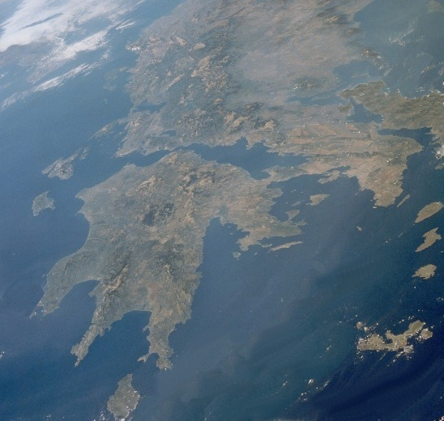
Corinth/Athens
C
ô
R
I
NH
T
ô --- A T H E N
Hi lạp
Athen
Côrinhtô
Biển Ê giê
Achai
Địa Trung hải
© EBibleTeacher.com
Photo Courtesy of NASA
INDEX
Notes:
Paul’s journeys to Corinth and Athens were described in Acts 17 and 18. We have two letters that Paul sent to Corinth in the letters of 1st & Second Corinthians.

Slide 43
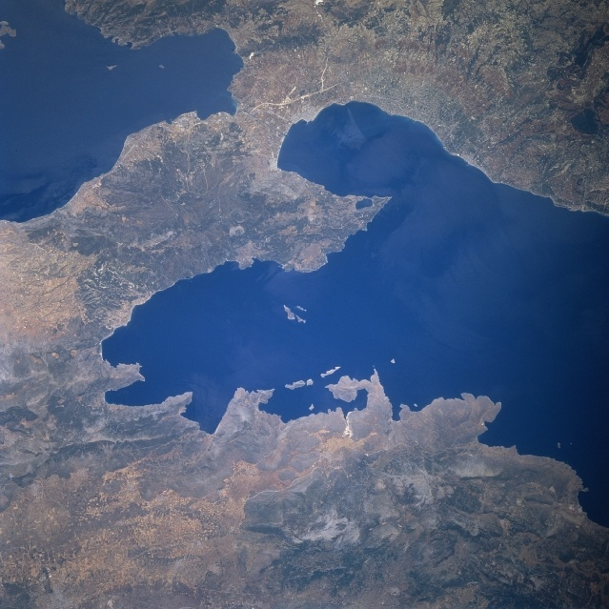
Corinth
Hi lạp
C
ô
R
I
NH
T
ô
Côrinhtô
Achai
© EBibleTeacher.com
Photo Courtesy of NASA
INDEX
Notes:
Paul’s journeys to Corinth and Athens were described in Acts 17 and 18. We have two letters that Paul sent to Corinth in the letters of 1st & Second Corinthians.

Slide 44
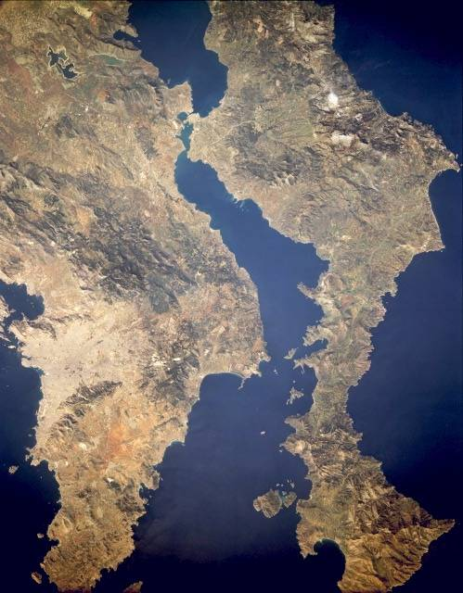
Athens
Photo Courtesy of NASA
A T H E N
Hi lạp
Athen
Biển Ê giê
© EBibleTeacher.com
INDEX
Notes:
Paul’s journeys to Corinth and Athens were described in Acts 17 and 18. We have two letters that Paul sent to Corinth in the letters of 1st & Second Corinthians.

Slide 45
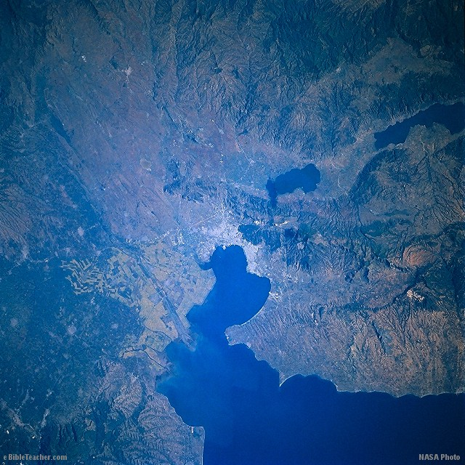
Thessalonica
MAXÊĐOAN
T
Ê
S
A
L
Ô
N
I
C
A
/
B
E
R
E
Têsalônica
Bê rê
Biển Ê giê
INDEX
Notes:
Paul’s journeys to Corinth and Athens were described in Acts 17 and 18. We have two letters that Paul sent to Corinth in the letters of 1st & Second Corinthians.

Slide 46
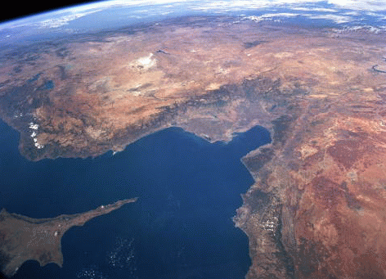
7 Churches of Asia (Revelation)
7 Hội thánh Á Châu
1
2
4
1 Bẹt găm
2 Thiatirơ
3 Sạt đe
4 Si miệc nơ
5 Philadelphi
6 Ê phê sô
7 Laođixê
3
6
5
7
© EBibleTeacher.com
INDEX
Notes:
The seven churches of Asia were written to in the book of Revelation in Revelation chapters 2 and 3.

Slide 47
Modern Israel
Liban
Syri
Địa Trung Hải
Galilee
Israel
Ngày nay
Bờ Tây
Tel Aviv
Giô đanh
Israel
Ngày nay
Jordani
Jerusalem
Biển Chết
Gaza
Negev(Negeb)
©
INDEX

Slide 48
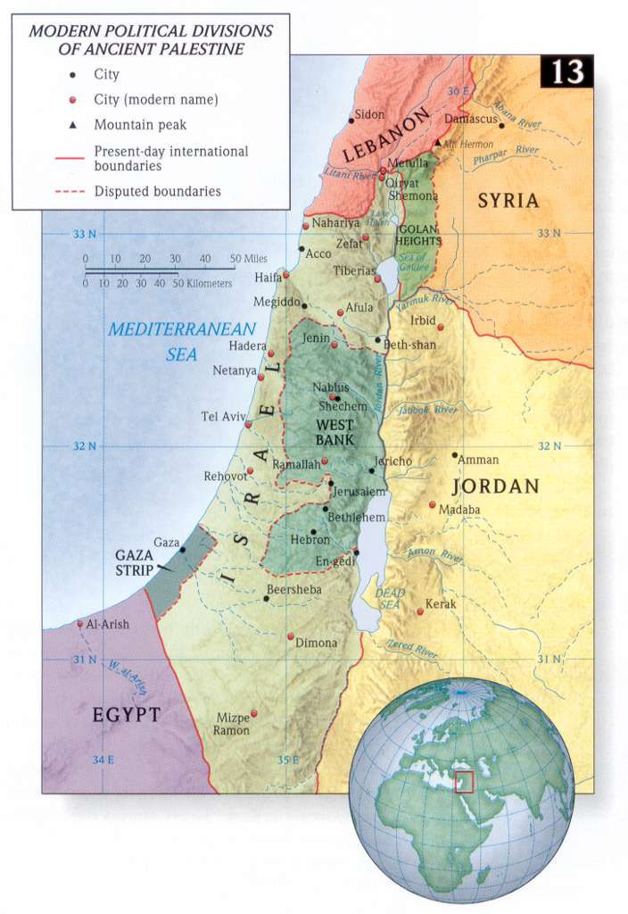

Slide 49

Cubit Diagram Sample
This is a sample page from “The World of the Bible” a PowerPoint Sunday School Series from eBibleteacher.com
B
I
B
L
E
Finger
18 Inches
= 1 Cubit
Span
Handbreadth
Length Measurement
© EBibleTeacher.com
INDEX
Notes:
The new “World of the Bible” series has over 450 slides and covers Bible lands, people, time, measurements and culture.
The ancient Bible people used measurements that could be easily reproduced. The cubit was simply the measurement from your elbow to the end of your fingers. Cubits are known to have varied from 16 to 19 inches. In the case of dispute, the king’s arm was used to determine the standard cubit.
Like the cubit, spans, handbreadth and fingers were also easily determined. Even today, some people still use these measurements such as in measuring horses.

Slide 50
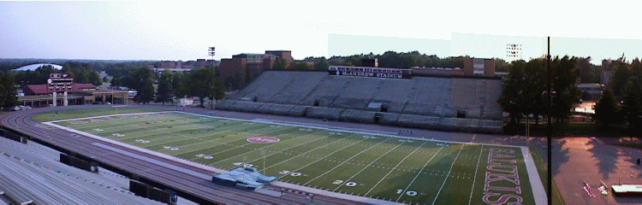
Kích cỡ tàu Nô ê
Con tàu dài 300 thước (‘cubits, 450 feet’ = 135 m) , ngang 50 thước (‘75 feet’= 22,5 m) và cao 30 thước (45 feet) Gen 6:15
INDEX

Slide 51
Sinai/Egypt Blank Map
Use this to Make your own map.
INDEX

Slide 52
Sinai/Egypt Blank Map
Use this to Make your own map.
INDEX

Slide 53
Israel Blank Map
Use this to Make your own map.
INDEX

Slide 54
Bible Lands Blank Map
Use this to Make your own map.
© EBibleTeacher.com
INDEX

Slide 55
Use this to Make your own map.
© EBibleTeacher.com
INDEX

Slide 56
Use this to Make your own map.
© EBibleTeacher.com
INDEX

Slide 57
Use this to Make your own map.
(Greece)
INDEX
Notes:
Greece.

Slide 58
Athens
Photo Courtesy of NASA
GREECE
Use this to make your own map
© EBibleTeacher.com
INDEX
Notes:
Greece with a view of the area around Athens.

Slide 59
Use this to Make your own map.
INDEX
Notes:
Modern day Turkey and the Isle of Cyprus.

Slide 60
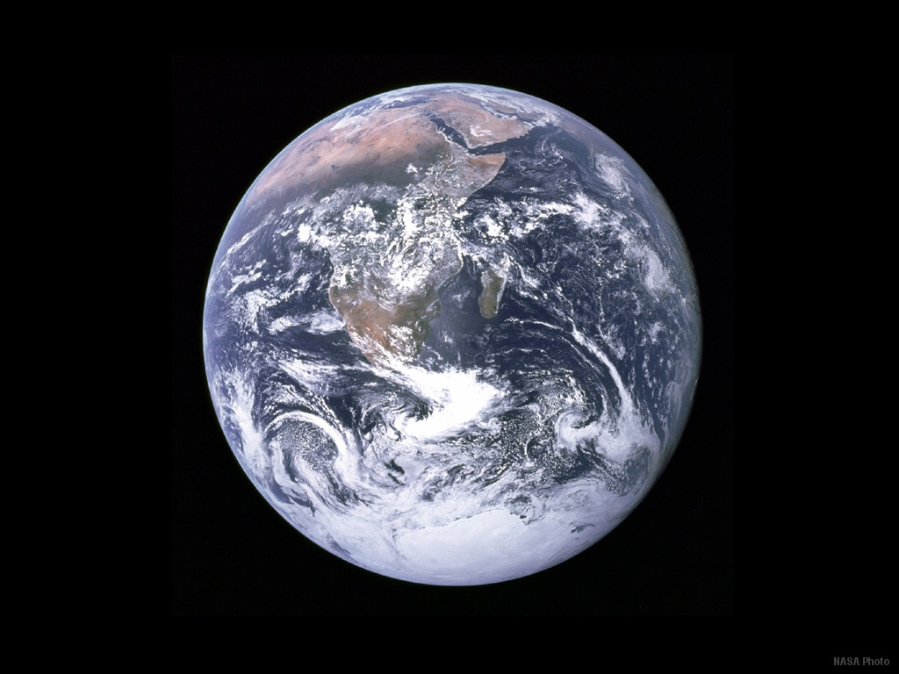
Earth from Space
NASA Photo
INDEX
Notes:
A NASA view of Earth from space.

Slide 61

Bề dài - Reed
6 Cubits = 1 Reed (9 Feet)
The “ R e e d ” was used for longer measurements.
INDEX

Slide 62
BIBLE WEIGHTS
60 Minas
= 1 Talent
10 Gerahs
= 1 Beka
Gerah
50 Shekels =
1 Mina
Beka
2 Bekas
= 1 Shekel
Mina
Shekel
INDEX

Slide 63
RESOURCES
For Sunday School Teachers using Computers
Free graphics and backgrounds for Sunday School teachers.
How-to guides for using video projectors, PC/TV converters and other electronic equipment.
Reviews of software and hardware for use in the Sunday School.
PowerPoint based Sunday School literature.
  “The Christian’s Personal Growth Class” 300+ PowerPoint slides and a 30+ page teacher’s guide. “Acts” 650+ PowerPoint slides & a 60+ page teacher’s guide. “Romans” 300+ PowerPoint slides & a 30+ page teacher’s guide. “Misc” set and images 300+ slides, also 1Cor, Gal, Eph, Phil, Col and more! Get nearly 4000 PowerPoint slides and over 100 printable pages of teacher’s guides total for a budget price. (Available 2004).
Visit eBibleTeacher.com at:
  www.ebibleteacher.com
  email: ttaylor@ebibleteacher.com
INDEX
Notes:
This web site has over 200 interactive web pages of things useful to Sunday School teachers.

Slide 64
About The Author
Terry Taylor is the webmaster of “eBibleTeacher.com” a website of resources for Bible Teachers who use the computer in the Sunday School (over 1 million visits). He is available for teaching classes and seminars about using the computer in the Sunday School.
Terry Taylor
609 Country Club Ln
Carterville, IL 62918
(618) 985 - 4527 email: taylor@ebibleteacher.com
INDEX
Notes:
Visit the web page to learn more about the author.

Slide 65
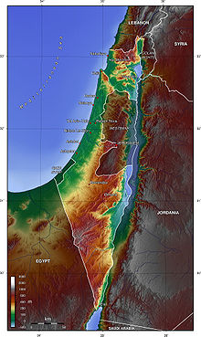
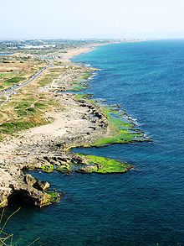
Bản đồ địa hình Israel
Vùng đồng bằng ven biển phía bắc

Slide 66


Địa Lý Kinh Thánh—BibleStudyDownloads.org
Tải Về Tài Liệu Nghiên Cứu Kinh Thánh
Notes:
Bible Geography VN

Slide 67
Black

